Slide 1
Plan-ting ideas for the holidays
Kelly Brock
Takeda Brief Updates/Planning Meeting 12/16/2015

Slide 2
Overview of projects
Using Bayesian statistics to predict which missense mutations will alter structure
Understanding tumor heterogeneity through the lens of CIN

Slide 3
Plan for break and January
Project | Specific Goal | Estimated Delivery
Missense mutations and Bayesian statistics | Full NAMD implementation | 12/18/2015
 | MD simulations running on Amazon clusters | 1/1/2015
 | Full matrices with probabilities | ~mid to late January, depending on how long simulations take to run
 | Confirmation of generality of probabilities | Late January
 | Proof of principle/initial tool presented to NGS | Early February
CIN project | Draft of Results section | 1/1/2015 (hopefully earlier)
 | Draft Editing/Full Draft for initial submission | Early February

Slide 4
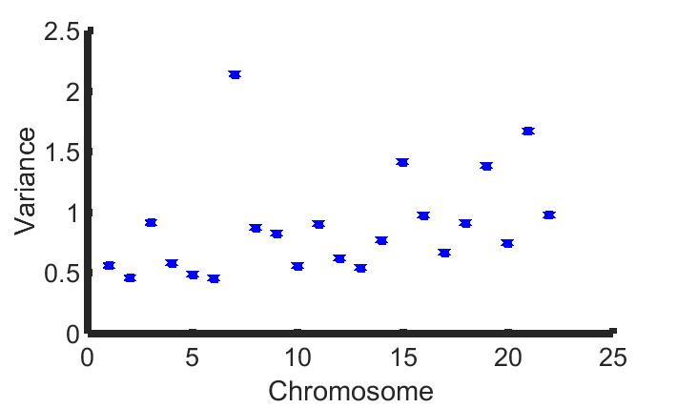
Variance of individual chromosomes
Notes:
Correlation: 0.3569, note weirdness of chromosome 7

Slide 5
These variables are not uncorrelated…
Variance of the sum: 135.5000
Sum of the variances: 19.5033
RMS of individual chromosome variances: 0.9802

Slide 6
Appendix

Slide 7
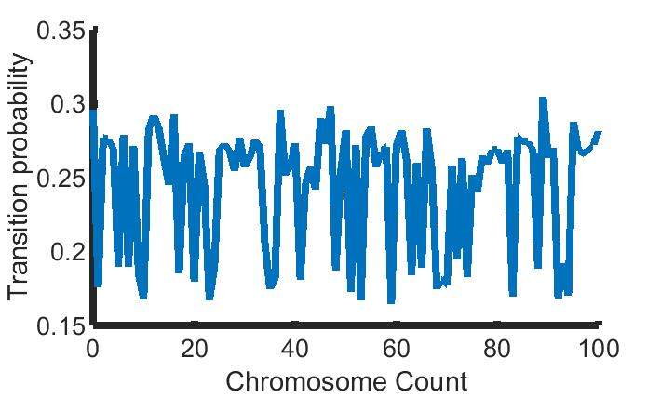
Minimization of transition probabilities in state machine model

